Slide 1
OT-ANG_390 The Major Periods Of English Drama: 20th century drama
Prof. Ivan Nyusztay

Slide 2
Modern British Drama
1890: Shaw’s lecture on “The Quintessence of Ibsenism”
Realism, naturalism vs idealism
Modernist attitude: therapeutic, social change, rejecting the past
The angry young men: Osborne
The Theatre of the Absurd: Samuel Beckett, Tom Stoppard, Harold Pinter

Slide 3
Naturalism
Raymond Williams, Culture and Society (1958): naturalism is
“a process of steadily excluding from the dramatic action any supernatural intervention or agency, so that the human action, however judged, is played in exclusively human terms”
A new sense of the material environment as a man-made world
new capitalist social order and altered relations between human beings and material things.
laws and factors that govern human lives can be explored and analysed by simply assessing human beings themselves, through their lives and actions.
scientific method used by naturalistic writers: studying human beings’ instincts and passions from a detached observer’s stance, taking note of the factors of heredity and environment in governing human lives.
Darwinian methodology, applying scientific research methods such as causality, determinism, experimentation and explanation to its study of human beings and observing human beings as though they were “products.”

Slide 4
George Bernard Shaw (1856-1950) “The Quintessence of Ibsenism”
Realism against idealism:
“Our ideals, like the gods of the old, are constantly demanding human sacrifices. Let none of them, says Ibsen, be placed above the obligation to prove itself worth the sacrifices it demands”
“The realist loses patience with ideals altogether, and sees in them only something to blind us, sg to numb us, sg to murder self in us…”
Introducing Ibsen to the English stage:
Life-denying idealism, internal contradictions, trapping the audience, discrediting socially conditioned reflexes, expectations
“The theatre is not there to amuse people, it’s object should be to make them think”

Slide 5
The function of theatre
Shock therapy: being shocked necessary for progress in society
Theatre: no refuge
Stage life: not idealized
No relief from omnipresent foulness
Spectator outraged as well as critics
Ibsen and Shaw: expose conventions
Ridicule the ‘well-made play’, theatrical artificialities

Slide 6
Shaw’s work
5 novels, 52 plays, political tracts, reviews, music criticism, essays, etc.
Nobel prize: 1925
Witticisms, humour, verbosity, eloquence
Social comedies: Pygmalion, Back to Methuselah, etc.
Historical plays: Caesar and Cleopatra, Saint Joan, etc.
Political writings: “The Intelligent Women’s Guide to Socialsim and Capitalism.” Marxist.
Concern with the future: “To Shaw most of the past is simply a mess which ought to be swept away in the name of progress, hygiene, efficiency and what not” (Orwell).
Optimistic: only reality is change

Slide 7
John Osborne (1929-1994)
“No brave causes left”: inability to act
Movement: towards isolation
‘Angry young men’
Kitchen-sink realism
Repetitive structure, circularity of action
Always Sunday: stasis and displacement
Alienation from society and introversion

Slide 8
Osborne: Anger and detachment
Look Back in Anger (1956)
Negativism: purely verbal rebellion
Theatrical vitality: constant flow of talk, clash of temperaments
Egocentricity, one-man diatribes
Rhetoric in a vacuum, detached from experience
Coping with vulnerability, appeal for pity and understanding

Slide 9
Osborne: Alienation
Alienation: boredom
Symptomatic of Dasein in anxiety (Heidegger)
Personality without direction and meaning
But: Jimmy is vitally active, confronts love, defeat, death
Campaign against apathy and deadness
Alison’s defence: imperturbability that fuels Jimmy’s attacks
Temporary solace in confessions, histrionics, sex

Slide 10
Osborne, The Entertainer (1957)
Jean: “Here we are, we’re alone in the universe, there’s no God, it just seems that it all began by sg as simple as sunlight striking on a piece of rock. And here we are. We’ve only got ourselves. Somehow, we’ve just got to make a go of it. We’ve only ourselves.”
On theatre: “Drama rests on the dynamic that is created btw characters on the stage. It must be concrete and it must be expressed, even if it is only in silence or a gesture of despair. The theatre is not a school room, nor is it, as many people seem to think, a place where ‘discussion’ takes place, where ideas are apparently, formally examined in the manner of a solitary show-off in an intellectual magazine. It is a place where people spend much of their time responding nakedly – or failing – to the burden of trying to live and preparing to die.”

Slide 11
The Theatre of the Absurd (M. Esslin)
Ab-surdus: deaf, unheard of
The myth of Sisyphus (Albert Camus)
Cyclicity vs linearity
Suspending action
Eugene Ionesco: "Absurd is that which is devoid of purpose. . . . Cut off from his religious, metaphysical, and transcendental roots, man is lost; all his actions become senseless, absurd, useless“
Thinking debunked (cf. Beckett and Pinter)
But: dignity of man manifest in repeated acts of verifying the absurd
Suicide: misunderstanding the absurd (Camus)

Slide 12
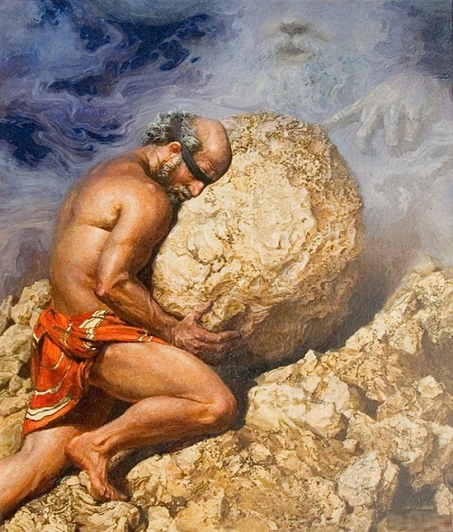

Slide 13
Samuel Beckett (1906-1989)
Novelist, dramatist, poet
Novels: Murphy, the trilogy (Molloy, Malone Dies, The Unnamable), Watt
Drama: full length plays (Waiting for Godot, Happy Days)
Minimalist plays: ‘Not I’, ‘Act Without Words’, ‘Rockaby’
From pairs to isolated characters
From isolated characters to body parts
Joyce vs Beckett: omniscience vs impotence

Slide 14
Beckett: major topics
Homo patiens and uselessness
Human choice: carrot or turnip
Claustrophobia: mounds (Happy Days), ashbins (Endgame), urns (Play)
Entertainment: thinking and dancing
Lack of causality, beginning and end
Constipation: verbal and physical
Language: self-referential, repetitive
The pitfalls of habit

Slide 15
Beckett: Waiting for Godot (1955)
Key word: perhaps
No place no time
The thieves crucified with Christ
Nothing happens: twice (2 Acts)
Pairs: Didi and Gogo, Pozzo and Lucky
Godot: not God
Characters tied to the spot
Contradictions: “I’m going”

Slide 16
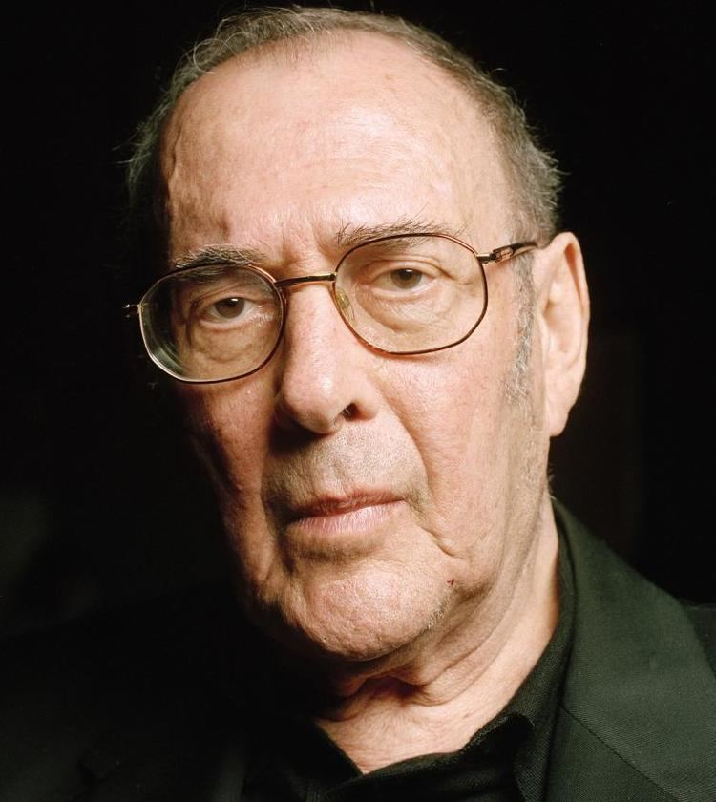

Slide 17
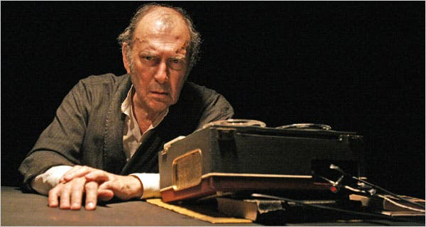
Pinter playing Beckett

Slide 18
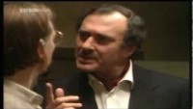
The Birthday Party
https://www.youtube.com/watch?v=H4K__NRJSDg

Slide 19
Harold Pinter (1930-2008)
Dramatist, poet, political essayist
Short and full-length plays
Condensation of life: the room plays (The Room, The Birthday Party, The Caretaker, The Dumb Waiter)
Beckettian pairs and a third
Dramas of alterity
Objection to symbolism

Slide 20
Pinter’s language and silence
Coercive language vs referential language
Language of familiarity: breakfast ritual, newspaper, etc
How to do things with words (J. L. Austin)
How to do things with silence
Silence: two types
Silence and communication in A Slight Ache (1958)
“One way of looking at speech is to say that it is a constant stratagem to cover nakedness.”

Slide 21
Pinter and the Room
“Given a man in a room and he will sooner or later receive a visitor. A visitor entering the room will enter with intent. If two people inhabit the room the visitor will not be the same man for both. A man in a room who receives a visit is likely to be illuminated or horrified by it. The visitor himself might as easily be horrified or illuminated. A man in a room and no one entering lives in expectation of a visit…But however much it is expected, the entrance, when it comes, is unexpected and almost always unwelcome”

Slide 22
The room symbolism
The room as theatre
Room realism: domestic
Settings: parts of London
The room as womb
The room as tomb
The room as doom

Slide 23
Pairs and the Third
The Third arrives but never as expected
The Third has always been there
The Third is variable
Ethics and politics
Internal alterity
Topics: hospitality, responsibility, the menacing external (and internal) world, dying, betrayal, gender roles, etc

Slide 24
The Birthday Party (1957)
Boarding house run by Meg and Petey
Only tenant: Stanley Weber
Guest son, host mother
Invading others: Goldberg and McCann
Organizing ‘birthday party’: rebirth
Darkness: blind man’s buff
Violence, rape
“You betrayed the organization”

Slide 25
Pinter: The Dumb Waiter (1960)
Unique pair: Ben and Gus
Basement room
Waiting for order
Language use controversy
D.W.: non-correspondence btw order and service
Breakdown of communication
Ambiguity overwhelming: Ben about to kill Gus?

Slide 26
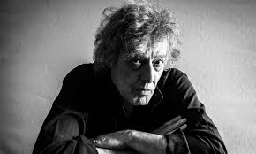

Slide 27
Tom Stoppard (1937-)
Dramatist, writer of film scenarios
Early plays influenced by Beckett (Ros and Guil are Dead)
New topics: philology (Arcadia), logic (Jumpers), physics Hapgood), history (The Coast of Utopia)
Shakespeare reloaded: Dogg’s Hamlet, Kohout’s Macbeth)
Vaclav Havel, Samuel Beckett and Tom Stoppard
Film scenario: Shakespeare in Love

Slide 28
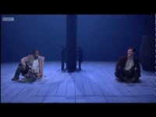

Slide 29
Stoppard: Rosencrantz and Guildenstern are Dead (1967)
Characters from Hamlet: change of perspective
Heads or tails: lose their heads
Players: parody and ridicule of Elizabethan theatre
Mission: “glean what afflicts him”
Mission impossible: lack of understanding
2 languages: Elizabethan vs Stoppardian
The question-answer game (youtube video)
Victims of unintelligible powers

Slide 30
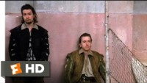

Slide 31
The Real Inspector Hound (1961-62)
Postmodern ‘Whodunit’
Crime story conventions challenged
The inspector from Poe’s Chevalier Dupin to Doctor House
Chaos and cosmos
Rationality vs the absurd
Critics: Birdboot and Moon
Boot: Beckettian burlesque
Moon: Stoppardian lunacy

Slide 32
Shakespeare and the absurd
Hamlet
Ros and Guil are Dead
Heroism
Mission: set the time right
Establish the situation
Choice
Suffering: readiness
Language: Elizabethan
Truth: found
Putting 7 people in a coffin
Antiherosim
Mission: to understand
Situation established them
Alternatives
Suffering: no explanation
Language: 2 versions
Truth: unattainable
Being in a box from the beginning

Slide 33
Edward Bond (1934-): Lear (1971)
"I write about violence as naturally as Jane Austen wrote about manners.“
Violence of modern society
Theatre of cruelty (Artaud) and Saved (1965)
Desire for power
Murder, rape, suffering
Seeing and being blinded (Lear)
Alienation effect (Brecht): asides
Intellect rather than emotions

Slide 34
Caryl Churchill (1938-)
Abuses of power and technology
Sexual politics (gender) and feminist themes
Farce, absurd, surrealism
Comedies, verse-plays, librettos, radio plays
Grotesque, alienation, social stereotypes
Owners (1972): private property (owning the material world and the other)
2 radioplays on psychiatrists and patients: who is normal? What is acceptable?

Slide 35
Cary Churchill: language
Words vs silences (Pinter)
Rhythm of language, precise authorial instructions (Beckett)
Broken, unfinished sentences
Experiments with words, different versions for completion
Digressions and repetitions (Stoppard)
Language detached from reality (Pinter)

Slide 36
Topics in Churchill
Ecocriticism: Not Not Not Not Not Enough Oxygen (1971)
Using of oxygen sprays at home and fragmented speech
Caricatures of celebrities, self-realization, successful carriers: Top Girls (1982) on women, Serious Money (1987) on men (male-dominated carriers)
Technology: A Number (2002): cloning
The individual is not unique, being one of the replicas,
foreboding tone

Slide 37
Martin MacDonagh (1970-)
Film director and playwright
Irish settings, themes: The Leenane Trilogy, The Aran Islands Trilogy
Hangmen (2015): “traditional comedy thriller”
Cruelty, menace, violence
“Pinter’s early works were full of menace and caught that peculiar tension between everyday England and the darkness that often lurked just beneath”
Insisting on film: theatre "is never going to be edgy in the way I want it to be”

Slide 38
Back to Beckett and Pinter: Coda

Slide 39
THANK YOU FOR YOUR KIND ATTENTION!

